Slide 1
Data Structure
CSE-207
Md. Manowarul Islam
Dept. of CSE, Jagannath University

Slide 2
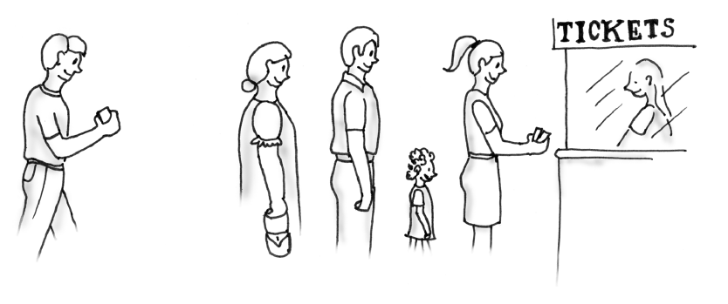
Simulating a Waiting Line
A line, or queue, of people

Slide 3
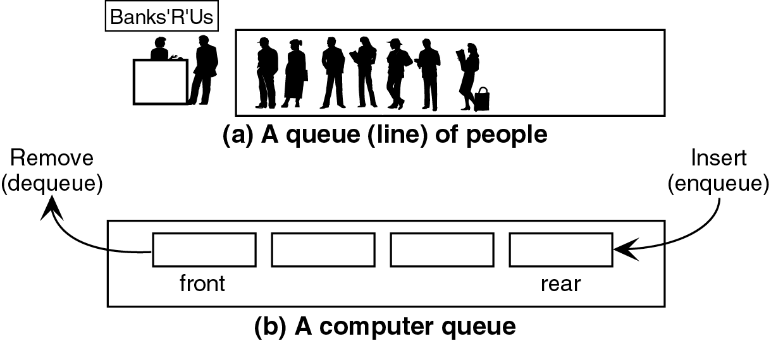
Queue
It is a linear data structure consisting of list of items.
In queue, data elements are added at one end, called the rear and removed from another end, called the front of the list.

Slide 4
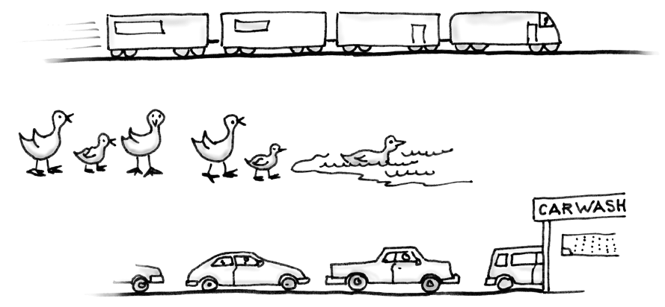
Some everyday queues

Slide 5
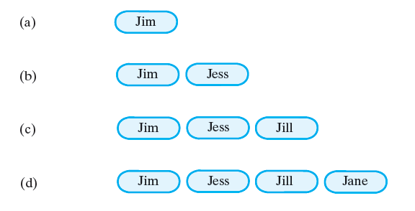
A queue of strings after (a) enqueue adds Jim;
(b) enqueue adds Jess; (c) enqueue adds Jill;
(d) enqueue adds Jane;

Slide 6
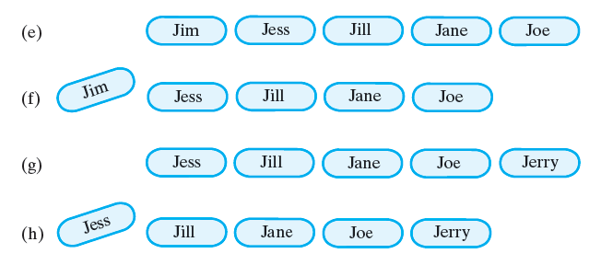
A queue of strings after (e) enqueue adds Joe; (f) dequeue retrieves and removes Jim; (g) enqueue adds Jerry; (h) dequeue retrieves and removes Jess;

Slide 7
Queue
A queue is a first in, first out (FIFO) data structure
This is accomplished by inserting at one end (the rear) and deleting from the other (the front)
0 1 2 3 4 5 6 7
myQueue:
17
23
97
44
front = 0
rear = 3
To insert: put new element in location 4, and set rear to 4
To delete: take element from location 0, and set front to 1

Slide 8
Queue
Two basic operations are associated with queue:
“Insert” operation is used to insert an element into a queue.
  Called enqueue operation
“Delete” operation is used to delete an element from a queue.
  Called dequeue operation

Slide 9
Queue
Example:
Queue: AAA, BBB, CCC, DDD, EEE
7
6
1
2
3
4
5
6
7
EEE
5
AAA
BBB
CCC
DDD
EEE
DDD
4
Front
CCC
3
Rear
BBB
2
AAA
1
Front

Slide 10
Queue
rear is the location in which the data element is to be inserted.
front is the location from which the data element is to be removed.
When queue is empty
  rear=-1
  front=-1
Adding an element in queue will increase the value of rear
  rear=rear+1;
Removing an element in queue will increase the value of front
  front=front+1;

Slide 11
Array implementation of queue
Queue empty rear=-1 front=-1

Slide 12
Array implementation of queue
Queue empty rear=-1 front=-1
Add 10, rear=0 front=0
10

Slide 13
Array implementation of queue
Queue empty rear=-1 front=-1
Add 10, rear=0 front=0
10
Add 20, rear=1, front=0
10
20

Slide 14
Array implementation of queue
Queue empty rear=-1 front=-1
Add 10, rear=0 front=0
10
Add 20, rear=1, front=0
10
20
Add 30, rear=2, front=0
10
20
30

Slide 15
Array implementation of queue
Queue empty rear=-1 front=-1
Add 10, rear=0 front=0
10
Add 20, rear=1, front=0
10
20
Add 30, rear=2, front=0
10
20
30
Add 40, rear=3, front=0
10
20
30
40

Slide 16
Array implementation of queue
Add 40, rear=3, front=0
10
20
30
40
Remove, rear=3, front=1
20
30
40

Slide 17
Array implementation of queue
Add 40, rear=3, front=0
10
20
30
40
Remove, rear=3, front=1
20
30
40
Remove, rear=3, front=2
30
40

Slide 18
Array implementation of queue
Add 40, rear=3, front=0
10
20
30
40
Remove, rear=3, front=1
20
30
40
Remove, rear=3, front=2
30
40
Add 60, rear=4, front=2
30
40
60

Slide 19
Queue
front = 0
rear = 3
Initial queue:
17
23
97
44
After insertion:
17
23
97
44
333
After deletion:
23
97
44
333
front = 1
rear = 4
Notice how the array contents “crawl” to the right as elements are inserted and deleted
This will be a problem after a while!

Slide 20
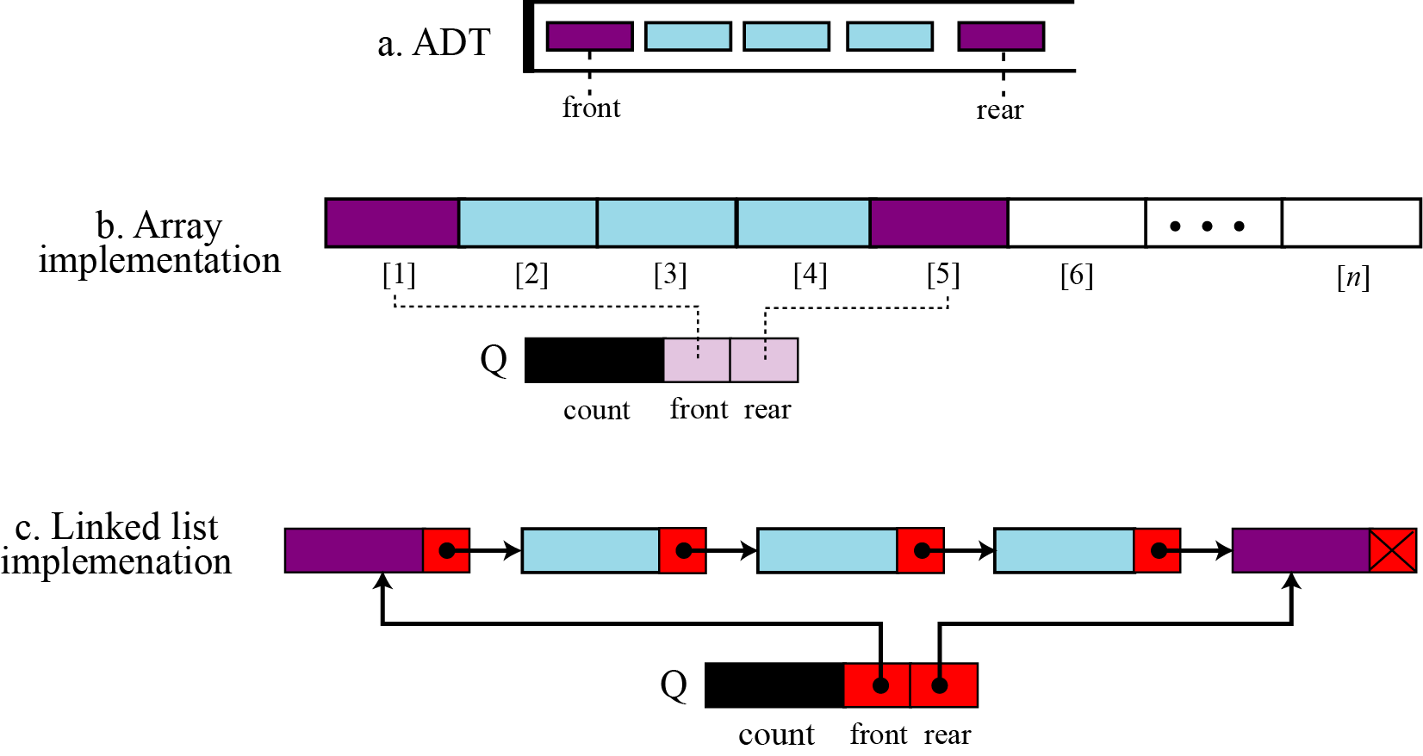
Queue

Slide 21
Insert Operations in Linear Queue
Rear is the location in which the data element is to be inserted.
Front is the location from which the data element is to be removed.
Here N is the maximum size of the Queue
1. If Rear = N then Print: Overflow and Return. /*…Queue already filled..*/
2. Set Rear := Rear +1
3. Set Queue[Rear] := Item
4. Return.

Slide 22
Delete Operations in Linear Queue
Rear is the location in which the data element is to be inserted.
Front is the location from which the data element is to be removed.
Here N is the maximum size of the Queue
1. If Front = N+1 then Print: Underflow and Return. /*…Queue Empty*/
2. Set Item := Queue[Front]
3. Set Front := Front + 1
4. Return.

Slide 23
Problem
Once the queue is full, rear has already reached the Queue’s rear most position
Even though few elements from the front are deleted and some occupied space is relieved,
it is not possible to add anymore new elements
1 2 3 4 5 6 7
77
88
11
22
33
front = 3
rear = 7

Slide 24
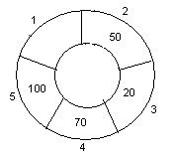
Circular queue
We can treat the array holding the queue elements as circular (joined at the ends)
Once the Queue is full the "First" element of the Queue becomes the "Rear" most element, if and only if the "Front“ has moved forward
1 2 3 4 5 6 7
55
11
22
33
rear = 1
front = 5
Front
Rear

Slide 25
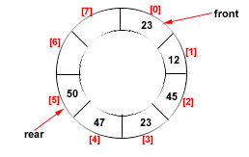
Drawback of Linear Queue
Once the queue is full, even though few elements from the front are deleted and
some occupied space is relieved, it is not possible to add anymore new elements,
as the rear has already reached the Queue’s rear most position.
Circular Queue
This queue is not linear but circular.
Its structure can be like the following figure:
In circular queue, once the Queue is full the
"First" element of the Queue becomes the
"Rear" most element, if and only if the "Front"
has moved forward. otherwise it will again be
a "Queue overflow" state.
Figure: Circular Queue having
Rear = 5 and Front = 0

Slide 26
For Insert Operation
Rear is the inserting location
Front is the removing location.
Here N is the maximum size of the Cqueue
Initailly Rear = 0 and Front = 0.
If Front = 0 and Rear = 0
  then Set Front := 1 and go to step 4.
2. If Front =1 and Rear = N or Front = Rear + 1
then Print: “Circular Queue Overflow” and Return.
3. If Rear = N then Set Rear := 1 and go to step 5.
4. Set Rear := Rear + 1
5. Set CQueue [Rear] := Item.
6. Return

Slide 27
For Delete Operation
Rear is the inserting location
Front is the removing location.
Here N is the maximum size of the Cqueue
Front element is assigned to Item, initially, Front = 1.
1. If Front = 0 then
Print: “Circular Queue Underflow” and Return. /*..Delete without Insertion
2. Set Item := CQueue [Front]
3. If Front = N then Set Front = 1 and Return.
4. If Front = Rear then Set Front = 0 and Rear = 0 and Return.
5. Set Front := Front + 1
6. Return.

Slide 28
For Delete Operation
Delete-Circular-Q(CQueue, Front, Rear, Item)
Here, CQueue is the place where data are stored. Rear represents the location in which the data element is to be inserted and Front represents the location from which the data element is to be removed. Front element is assigned to Item. Initially, Front = 1.
1. If Front = 0 then
Print: “Circular Queue Underflow” and Return. /*..Delete without Insertion
2. Set Item := CQueue [Front]
3. If Front = N then Set Front = 1 and Return.
4. If Front = Rear then Set Front = 0 and Rear = 0 and Return.
5. Set Front := Front + 1
6. Return.

Slide 29
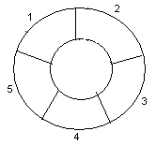
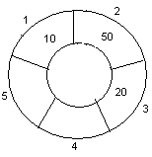
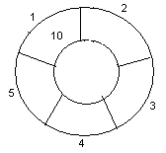
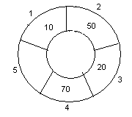
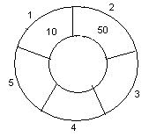
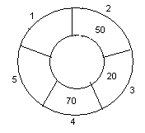
Circular queue
1. Initially, Rear = 0, Front = 0.
4. Insert 20, Rear = 3, Front = 1.
Front
Rear
2. Insert 10, Rear = 1, Front = 1.
5. Insert 70, Rear = 4, Front = 1.
Rear
Front
Front
3. Insert 50, Rear = 2, Front = 1.
Rear
6. Delete front, Rear = 4, Front = 2.
Front
Rear
Front
Rear

Slide 30
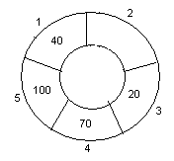
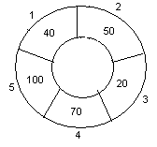
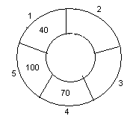
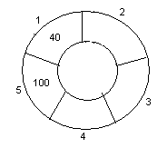
Circular queue
7. Insert 100, Rear = 5, Front = 2.
10. Delete front, Rear = 1, Front = 3.
Front
Rear
Front
Rear
8. Insert 40, Rear = 1, Front = 2.
11. Delete front, Rear = 1, Front = 4.
Rear
Rear
Front
Front
9. Insert 140, Rear = 1, Front = 2.
As Front = Rear + 1, so Queue overflow.
12. Delete front, Rear = 1, Front = 5.
Rear
Rear
Front
Front

